Slide 1
Capstone project ideas
By Mashitah Susanto

Slide 2

Initial capstone idea
Predicting trends of a food delivery app in Indonesia (GoFood, Grabfood, Shopee food) – which type of restaurants / food will be the next go-to delivery option(s) for customer in 2022?
Limitation: could not find the complete dataset for this topic

Slide 3
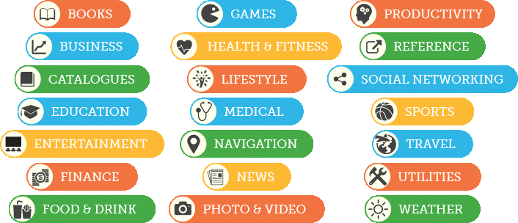
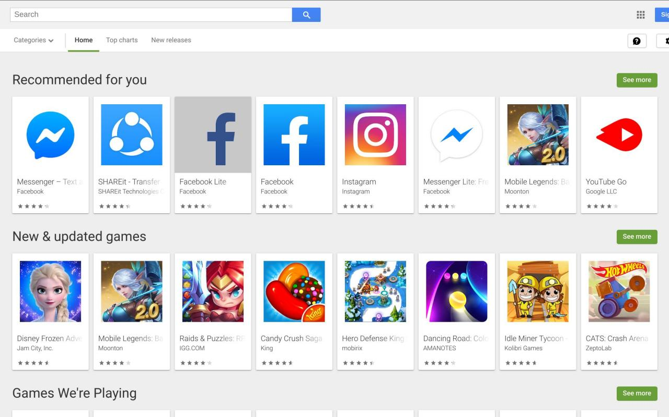
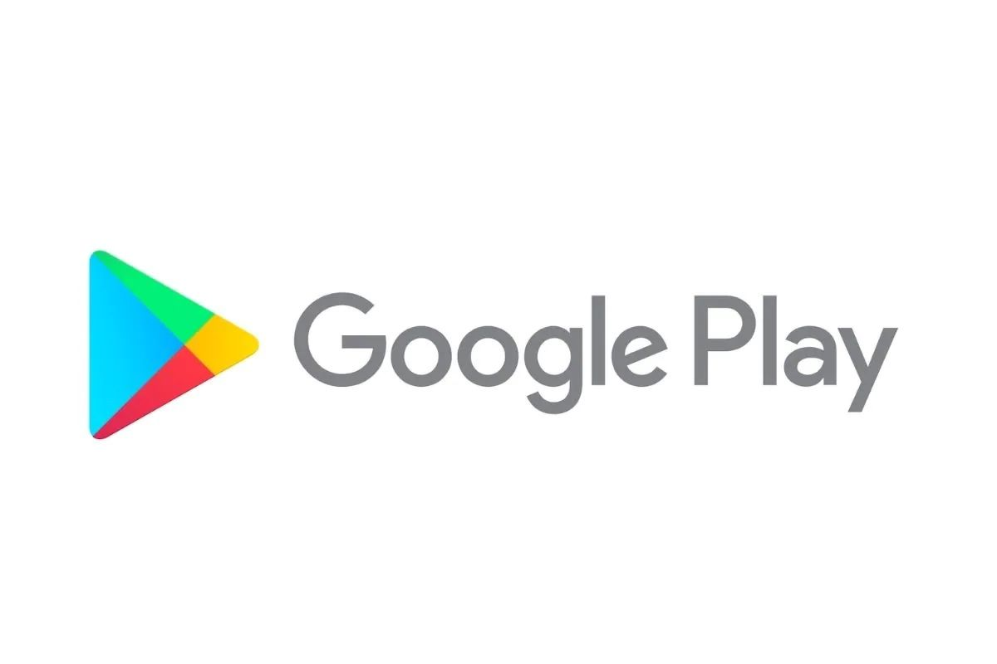
Google play store
When is the best season to release a gaming app?
Google Play users worldwide downloaded 108.5 billion mobile apps (2020) , & up from 76 billion apps in 2018.
It generates significantly more downloads than the Apple App Store, as it is available for a wider range of devices
Other possible problem statement:
Predicting the popularity of an app in Google play store

Slide 4



Target Audience
Mobile app developer, App user, Big gaming companies
Goal
To analyse whether the release date of gaming & educational app correlates with the school calendar (summer holiday, winter holiday, back to school era)
Usefulness
I am able to help app developers predict which season is best for them to release the app into the google playstore, to ensure higher chance of popularity.

Slide 5
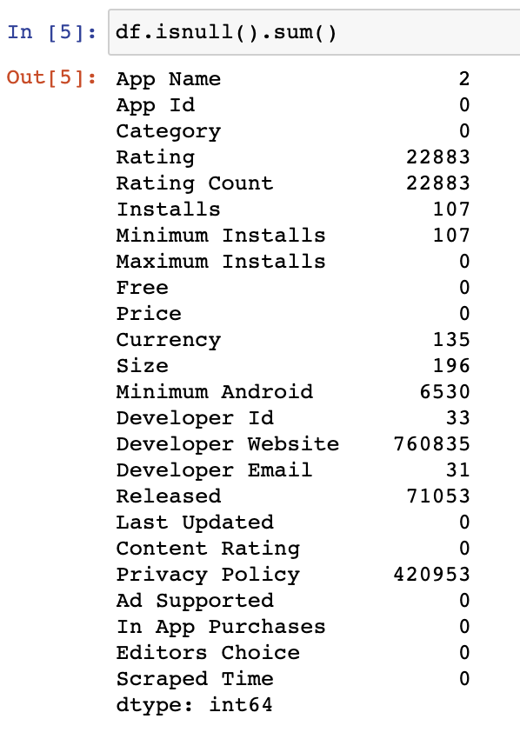
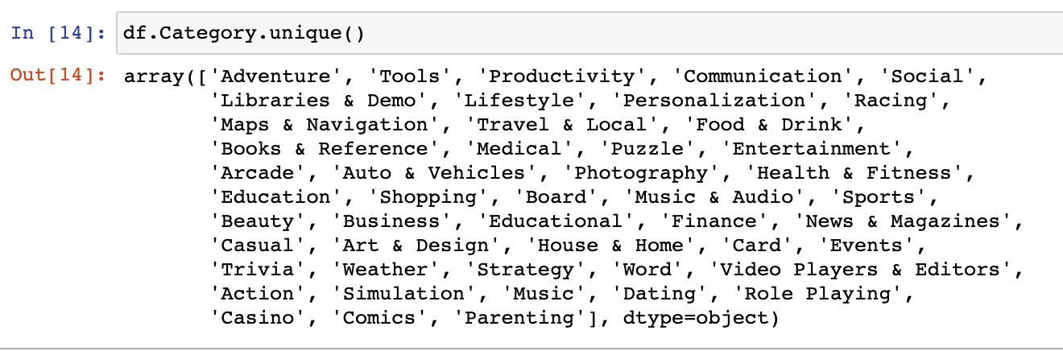
Method use
EDA, classification report, model coefficient, heatmap, data visualization, clustering
Success matrix: determining accuracy of the prediction (confusion matrix)
Data use
https://www.kaggle.com/gauthamp10/google-playstore-apps
Google playstore dataset from Kaggle, which contains 2,312,944 rows & 24 columns involving app release date, category, number of installs, ratings, & more.
I will also be using the internet to find out the most common school holidays, as well as back to school era.

Slide 6
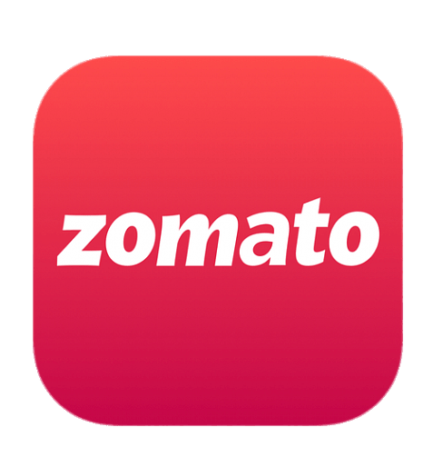
Zomato restaurants
What is the most common variables that affects the restaurant’s overall rating in Zomato?
Zomato is a multinational Indian companies which provides information, menus and user-reviews of restaurants as well as food delivery options from partner restaurants in select cities.

Slide 7
Target Audience
Restaurant Owner, Customer , Tourists
Goal
To identify the main factors affecting the customer’s rating in Zomato, hence enable restaurant owner to improve on a certain variables to regain popularity
Usefulness
The result will help restaurant owner figure what is affecting the rating of their restaurants – services, location, or price?

Slide 8
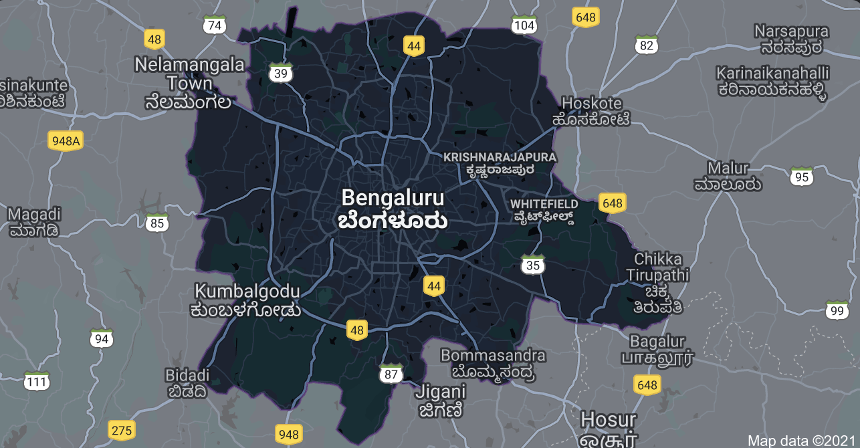
Method use
Classification report, data visualization, Clustering
Success matrix: determining accuracy of the prediction (confusion matrix)
Data use
https://www.kaggle.com/himanshupoddar/zomato-bangalore-restaurants
Zomato Bengaluru dataset from Kaggle

Slide 9
Other potential topic
Forbes Billionaire Dataset :
https://www.kaggle.com/jaytilala/forbes-worlds-billionaires-in-2018
https://www.kaggle.com/roysouravcu/forbes-billionaires-of-2021
To analyse the rise of Asian billionaire from 2018 to 2021
Does pandemic affects the industry – more billionaires from tech industry
Limitations : not enough rows & columns

